Slide 1
PRESENTATION
Philosopher Dining Hall Problem

Slide 2
Group Members:
Kashif Muneer (2021-CE-34)
Mehmood Ul Haq (2021-CE-35)
Shahzaib Ramzan (2021-CE-41)
Talal Muzammal (2021-CE-47)

Slide 3
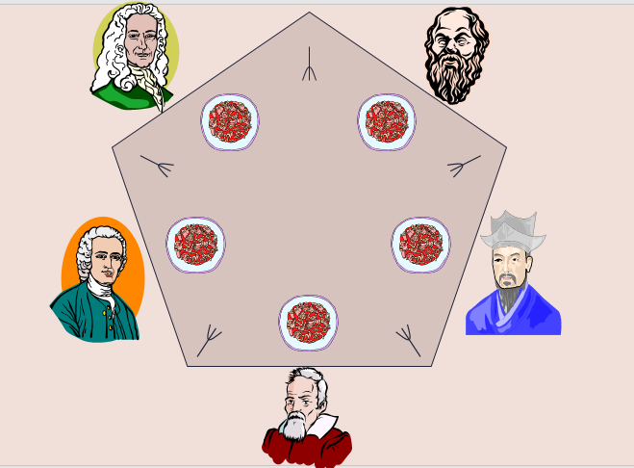
Introduction
Problem Overview
The Dining Philosophers Problem involves multiple philosophers sitting around a dining table, thinking, and eating.
Challenge: Avoid conflicts over shared resources (forks).

Slide 4
Solution Components
01.
Threaded Execution:
02.
Locks and Condition Variables:
Each philosopher is a separate thread.
Locks control access to shared resources.
Condition variables handle synchronization between threads.

Slide 5
Code Overview
Global Variables:
NUMPHIL: Number of philosophers (5 in this case).
num_iterations: Number of iterations each philosopher goes through (thinking, eating, etc.).
LEFT and RIGHT: Functions to determine the indices of the philosophers to the left and right of a given philosopher.
state: An array representing the state of each philosopher (0 for thinking, 1 for hungry, 2 for eating).
identity: An array representing the identity of each philosopher.
lock: A global lock used for synchronization.
cond: A list of condition variables, one for each philosopher.

Slide 6
Functions:
think(id): Simulates the philosopher thinking for a random amount of time.
pickup_forks(id): Simulates the philosopher attempting to pick up forks and enter the eating state. It checks the state of adjacent philosophers to avoid conflicts.
eat(id): Simulates the philosopher eating for a random amount of time.
return_forks(id): Simulates the philosopher returning forks, allowing adjacent philosophers to potentially pick them up.

Slide 7
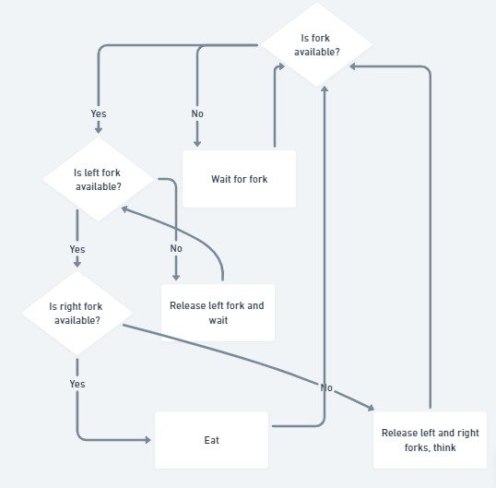
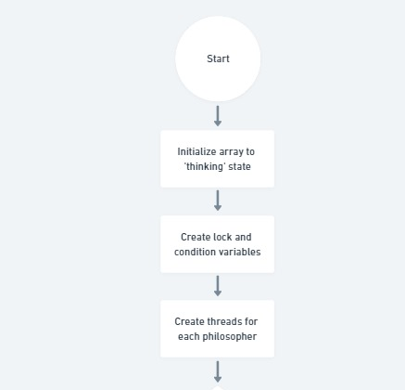
Flowchart:

Slide 8
Problem relation with bounded buffer:
Both problems involve managing shared resources to prevent conflicts and ensure coordinated access.
The use of locks and condition variables is common in both scenarios for enforcing mutual exclusion and coordinating activities.
Philosophers and producers/consumers need to wait for specific conditions to be met before proceeding with their actions.
Both problems are classic examples used to teach principles of concurrent programming, emphasizing the importance of synchronization and coordination.

Slide 9
Code Explanantion
01.
Section 1 (Code Setup)
02.
Section 2 (Defining Functions)
03.
Section 3 (Ending)

Slide 10
Code Explanation (Section 1)
Importing Libraries
import threading
import time
import random
Philosophers and Neighbours Configuration
state = [0] * NUMPHIL identity = [0, 1, 2, 3, 4]
lock = threading.Lock()
cond = [threading.Condition(lock) for _ in range(NUMPHIL)]
NUMPHIL = 5
num_iterations = 1
LEFT = lambda i: (i - 1 + NUMPHIL) % 5
RIGHT = lambda i: (i + 1) % 5
Philosophers states and synchronization setup:

Slide 11
Code Explanation (Section 2)
Philosophers' Thinking Simulation
def think(id):
think_time = random.randint(1, 3)
print(f"Philosopher {id} is thinking for {think_time} seconds")
time.sleep(think_time)
print(f"Philosopher {id} reappears from sleep from thinking")
Function Definition
Generate Random Thinking Time
Simulate Thinking Time

Slide 12
Code Explanation (Section 2)
Philosopher Fork Pickup and Eating Authorization
def pickup_forks(id):
left = LEFT(id)
right = RIGHT(id)
with lock:
state[id] = 1 # HUNGRY
while state[id] == 1 and (state[left] == 2 or state[right] == 2):
print(f"Philosopher {id} is hungry and waiting to pick up forks to eat")
cond[id].wait()
if state[id] == 1:
state[id] = 2 # EATING
print(f"Philosopher {id} is allowed to eat now")
Lock-Protected Fork Pickup
Waiting Mechanism
Eating Authorization

Slide 13
Code Explanation (Section 2)
Philosopher Eating Simulation
def eat(id):
eating_time = random.randint(1, 3)
print(f"Philosopher {id} is eating for {eating_time} seconds")
time.sleep(eating_time)
print(f"Philosopher {id} reappears from sleep from eating")
Random Eating Time Generation
Eating Duration Display
Sleep Simulation for Eating

Slide 14
Code Explanation (Section 2)
Returning Forks and Signalling Neighbours
def return_forks(id):
left = LEFT(id)
right = RIGHT(id)
with lock: state[id] = 0 # THINKING
print(f"Philosopher {id} has put down forks") cond[left].notify()
print(f"Philosopher {id} signaled philosopher {left} to see if it can eat")
cond[right].notify()
print(f"Philosopher {id} signaled philosopher {right} to see if it can eat")
Transition to Thinking State:
Notification of Fork Availability:
Neighbours Signalling Messages

Slide 15
Code Explanation (Section 3)
Loop Iterations
Iteration Control:
Philosophers go through the cycle for a set number of iterations.
Main Program:
Threads are created, started, and joined to ensure completion.

Slide 16
Challenges and Considerations
Deadlock Avoidance:
The solution ensures no deadlocks occur.
Concurrency Management:
Threads and synchronization mechanisms handle concurrent execution.

Slide 17
Conclusion
Achievements:
Successful concurrent solution to the Dining Philosophers Problem.
Considerations for Real-World Scenarios:
Scalability and performance considerations.

Slide 18
THANKS A LOT!
Do you have any questions?

